Slide 1
ECON3510 – Tutorial 3
Welcome to ZOOM!
Nicholas Umashev

Slide 2
Exercise 1 Ricardian Model

Slide 3
Part 1
Home |  |  | Foreign
TV | Cars |  | TV | Cars
w_{TV} = 12 | w_{c} = ? |  | w*_{TV} = ? | w*_{c} = 6
a_{TV} = 1/2 | a_{c} = ? |  | a*_{TV} = ? | a*_{c} = 1
P_{TV} = ? | P_{c} = 4 |  | P*_{TV} = 3 | P*_{c} = ?
At Home, what are: The unit labor requirement of cars? The autarchy relative price of TV?
At Foreign, what are: The unit labour requirement of TVs? The autarchy relative price of TVs?
Notes:
Answer 1: w_{TV}a_{TV}=P_{TV} implies P_{TV}=6 which implies P_{TV}/P_{C}=3/2 which implies a_{TV}/a_{C}=3/2 which implies a_{C}=1/3.
Answer 2: w*_{C}a*_{C}=P*_{C} implies P*_{C}=6 which implies P*_{TV}/P*_{C}=1/2 which implies a*_{TV}/a*_{C}=1/2 which implies a*_{TV}=1/2.

Slide 4
Part 2
Home |  |  | Foreign
TV | Cars |  | TV | Cars
w_{TV} = 12 | w_{c} = 12 |  | w*_{TV} = 6 | w*_{c} = 6
a_{TV} = 1/2 | a_{c} = 1/3 |  | a*_{TV} = 1/2 | a*_{c} = 1
P_{TV} = 6 | P_{c} = 4 |  | P*_{TV} = 3 | P*_{c} = 6
Suppose the world relative price of TVs equilibrium is P_{TV}/P_{C} =1. Which good will each country export?
In the trade equilibrium, what is the real wage at Home in terms of cars and in terms of TVs? How do these values compare with the real wage in terms of either good in the no-trade equilibrium?
In the trade equilibrium, what is the real wage in Foreign in terms of TVs and in terms of cars? How do these values compare with the real wage in terms of either good in the no-trade equilibrium?
In the trade equilibrium, do Foreign workers earn more or less than those at Home, measured in terms of their ability to purchase goods? Explain why.
Notes:
Answer 3: Home will export cars and Foreign will export televisions because Home has a comparative advantage in cars whereas Foreign has a comparative advantage in televisions. Each country will specialize in the goods with lower opportunity cost. No-trade price of televisions in Foreign is 1/2, lower than the world price of 1. So, Foreign will specialize in televisions, export televisions, but import cars. Autarky price of cars in Home is 2/3, lower than the world price of 1. So, Home will specialize in cars, export cars, and import televisions.
Answer 4: With trade, workers at Home are paid in terms of cars because Home exports cars. Home is better off with trade because its real wage in terms of televisions has increased. Home real wage in terms of cars is the same with or without trade and is equal to the labour productivity in cars which is 1/a_{C} = 3 cars. Home wage in terms of TV is 1/a_{TV} = 2 without trade. While is or (P_{C}/P_{TV}) / a_{C} = 3 units of TV.
Answer 5: With trade, Foreign workers are paid in terms of televisions because Foreign exports televisions. Foreign gains in terms of cars with trade. The Foreign wage with trade is (P_{TV}/P_{C}) / a*_{TV} = 2 units of cars or 1/ a* _{TV} = 2 units of TV. The Foreign wage without trade is (P*_{TV}/P*_{C}) / a *_{TV} = 1 unit of car or 1 / a*_{TV} = 2 units of TV.
Answer 6: At the trade equilibrium, the real wage for Foreign workers are either 2 cars or 2 televisions, whereas the real wage for Home workers is either 3 televisions or 3 cars. Foreign workers earn less than workers at Home in terms of cars because Home has an absolute advantage in the production of cars. Home workers also earn more than Foreign workers in terms of televisions. Under the Ricardian model, wage differences are determined by differences in productivity.

Slide 5
Exercise 2 Back to Unit Labor Requirements

Slide 6
Question 2
Table of Unit Labor Requirements
 | Computers | Education | Labor Hour Units
Japan | 1 | 16 | 320
Australia | 4 | 4 | 160
MRS is equal to total consumption of computers divided by total consumption of education in the country.
For question 2 the MRS is the same in both countries.
In autarchy, what is the production in each country and what is the relative price of education in term of computers? (do Japan first, then Australia)
What is the production, consumption, relative price of education and exports under free trade?
Notes:
Answer 1: In Australia the relative price is P_{E}/P_{C}=1 and Q_{E} = Q_{C}=20. In China, the relative price is P_{E}/P_{C}=16 and Q_{E} = Q_{C}=10.
Answer 2: Production: In Australia Q_{E}=40, Q_{C}=0. In China, Q_{C}=320, Q_{E}=0. Consumption: In Australia: Computer = 1600, education =20. In China, the same, computer =1600, education = 20. Australia exports education, 20 units and imports computer, 160. China imports education, 20 and export computers, 160. The relative price of education is P_{E}/P_{C} = 8.

Slide 7
Exercise 3 Garments

Slide 8
Question 3
“Bangladesh is the world’s second largest Readymade Garment (RMG) exporter, just behind China. … 81% of exports come from the RMG sector, and the textile and Apparel sector contributes around 20% to Bangladesh’s GDP. It employs around 20 million people… and is the major driving force of the country’s economy.”
https://medium.com/@stitchdiary/what-makes-bangladesh-a-hub-of-garment-manufacturing-ce83aa37edfc
How did it happen? What’s the economics?
Notes:
1

Slide 9
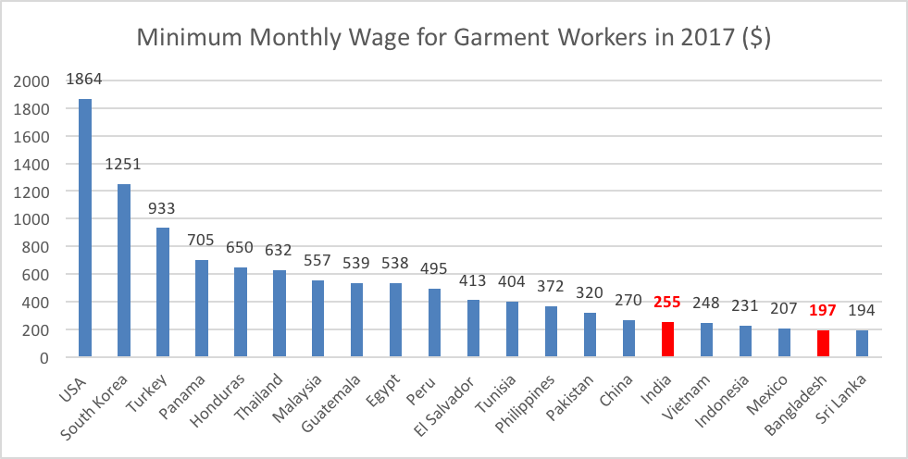
Question 3
Notes:
1

Slide 10
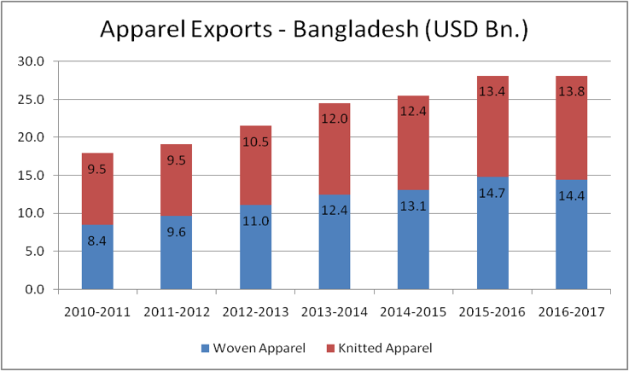
Question 3
Notes:
1

Slide 11
Question 3
Bangladesh has Least Developed Country (LDC) status that qualifies it for duty-free market access or reduced tariff facilities to many developed and developing nations, globally. Bangladesh enjoys duty-free access to around 52 countries, including countries in the EU, the USA, Australia, Switzerland, Japan, Turkey, Russia, Norway, New Zealand, China, South Korea, Thailand, Malaysia, and India, for the trade of many products.
There are 37 private and public universities producing textile graduates in the country every year, further adding to the skilled manpower for the segment. There are favourable government policies and bank facilities (for raw material purchase).
Bangladesh has attracted many major global retail brands, and with the technology and quality compliance parameters has also seeped in Bangladesh’s apparel manufacturing systems.
Notes:
1

